Slide 1
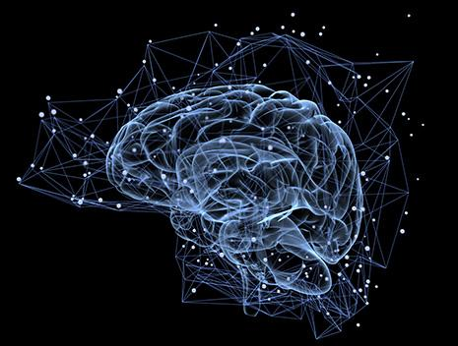
Bayesian Concept
Learning
Chelsea Zou

Slide 2
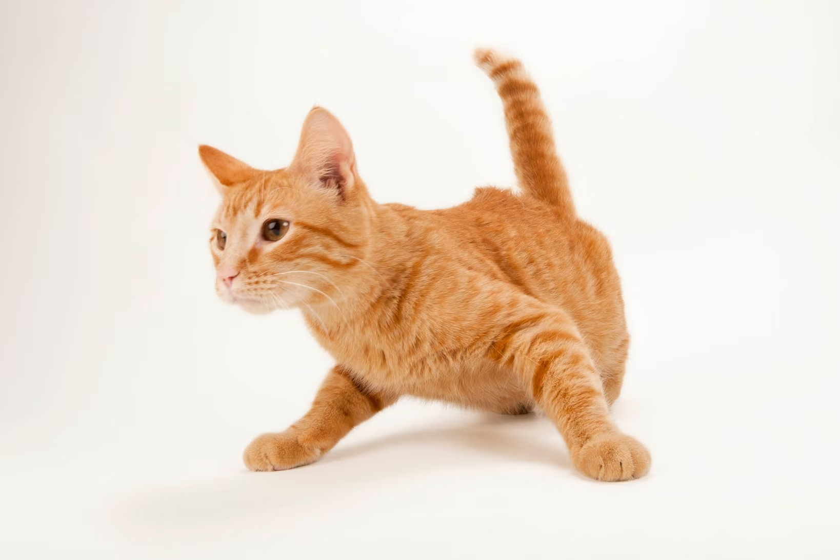



Question: How Do Humans Learn and Generalize Concepts from Specific Examples?
Is this a cat?
“Cats”

Slide 3


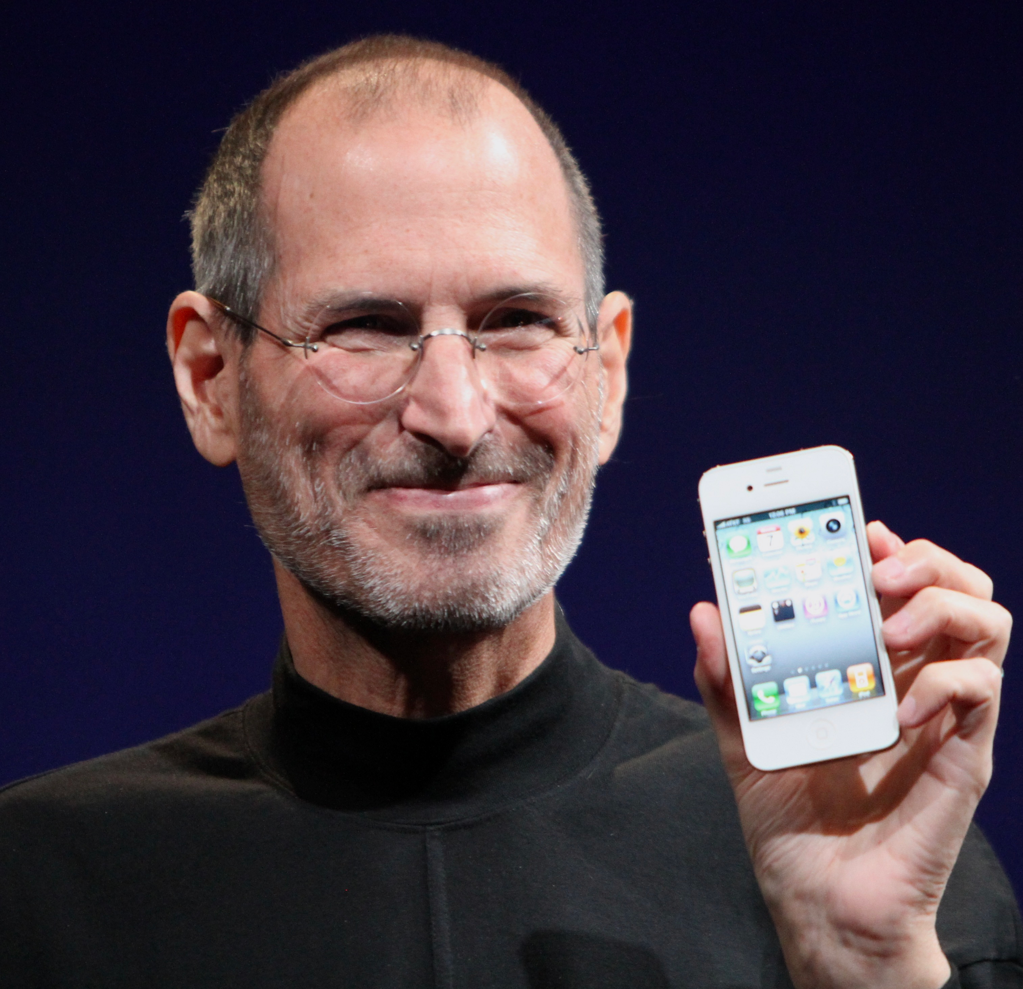
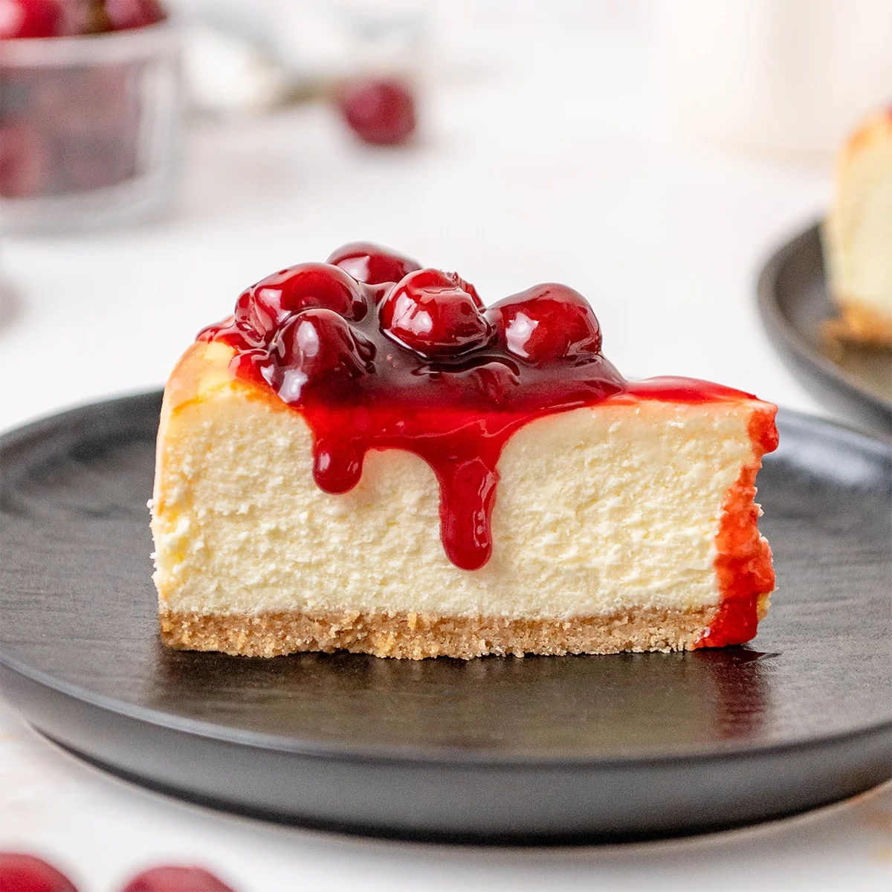


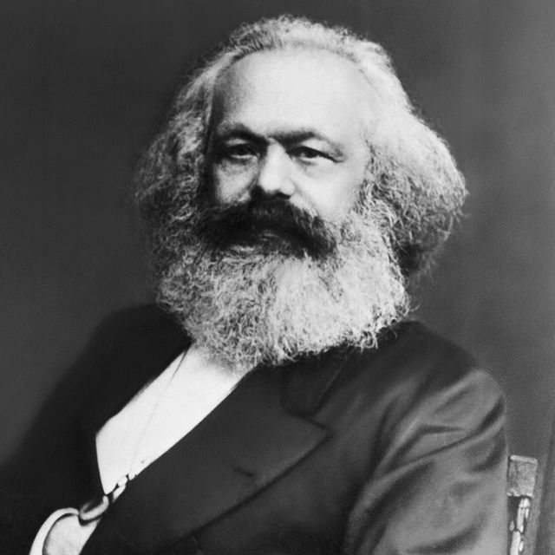

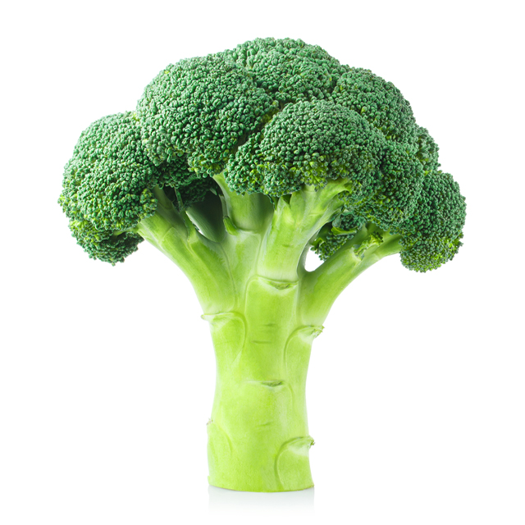
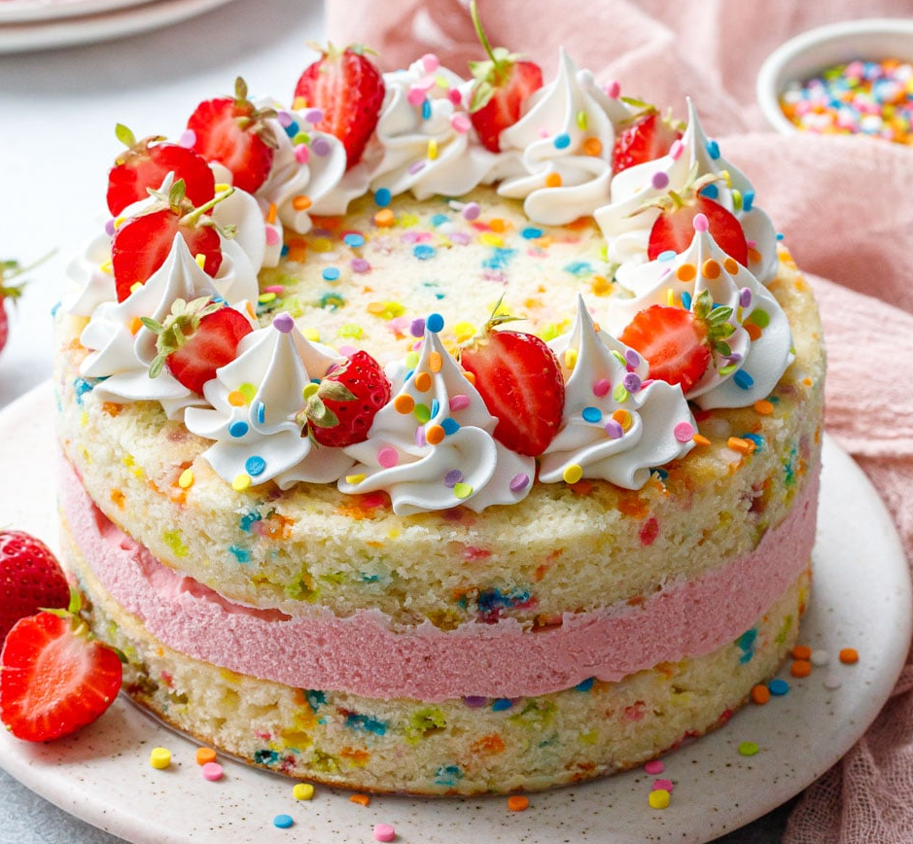


Background - Concept Learning
Searching for attributes that can be used to distinguish exemplars from non exemplars of various categories
Physical
Contextual

Slide 4

Background - Concept Learning
Classical Approach: Assigned category if exemplar meets definition of the category
Prototype Theory (Rosch 1973): Compares exemplar to a statistical average of all known instances
Exemplar Theory (Nosofsky 1991): Storing all instances in memory

Slide 5
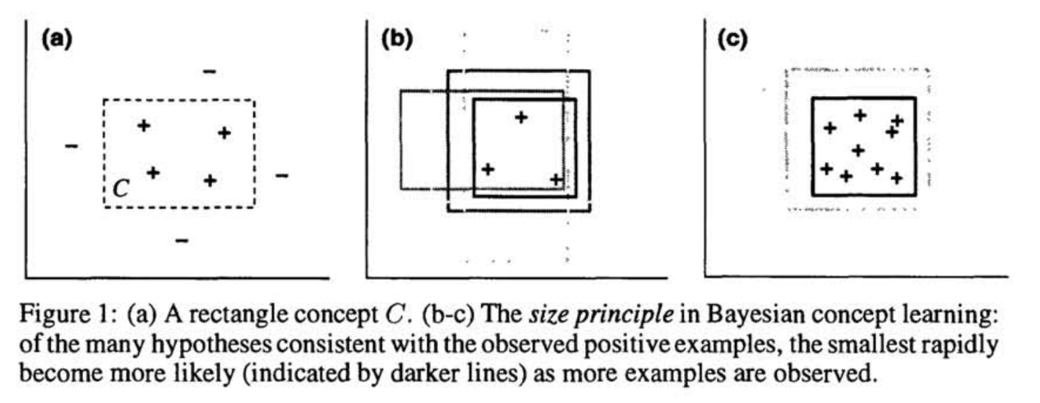
Background - Bayesian Learning Framework
Tenenbaum (1998) first proposed the formalization of Bayes Theorem with concept learning in a rectangular guessing task
Integration of Prior Knowledge: Learners combine prior knowledge with new observations.
Efficient Decision-Making: Enables efficient judgments about new information.
Subjects had to guess 2D rectangular concepts based on dots (observations) that represented instances of healthy levels of insulin and cholesterol.
The number of observations was manipulated during the experiments
Results: People tend to guess rectangles larger than the examples they saw if ranges of rectangle was larger. Interestingly, if there were more observations, people tend to make smaller sized guesses.

Slide 6
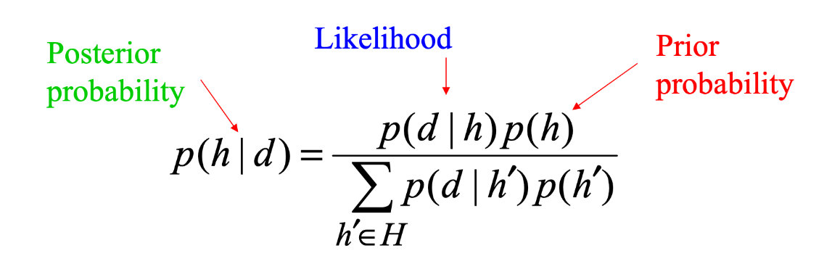
Bayes Theorem → How do humans update their beliefs in light of new information?
Prior p(h) = Prior knowledge state
Likelihood p(d|h) = New information/observations belonging to a concept
Posterior p(h|d) = Updated beliefs about a concept
Aim: How does the number of observations shown affect our ability to update our knowledge and learn concepts?

Slide 7

Disclaimers
Controversial: Quite a leap to go from formalisms of probability theory to something as complex as cognition
→ could just be a satisfying post-hoc explanation for how cognition works
Design of experiment oversimplifies something complicated and theoretical
Nonetheless, this experiment is still worthy of exploring an interesting analogy

Slide 8
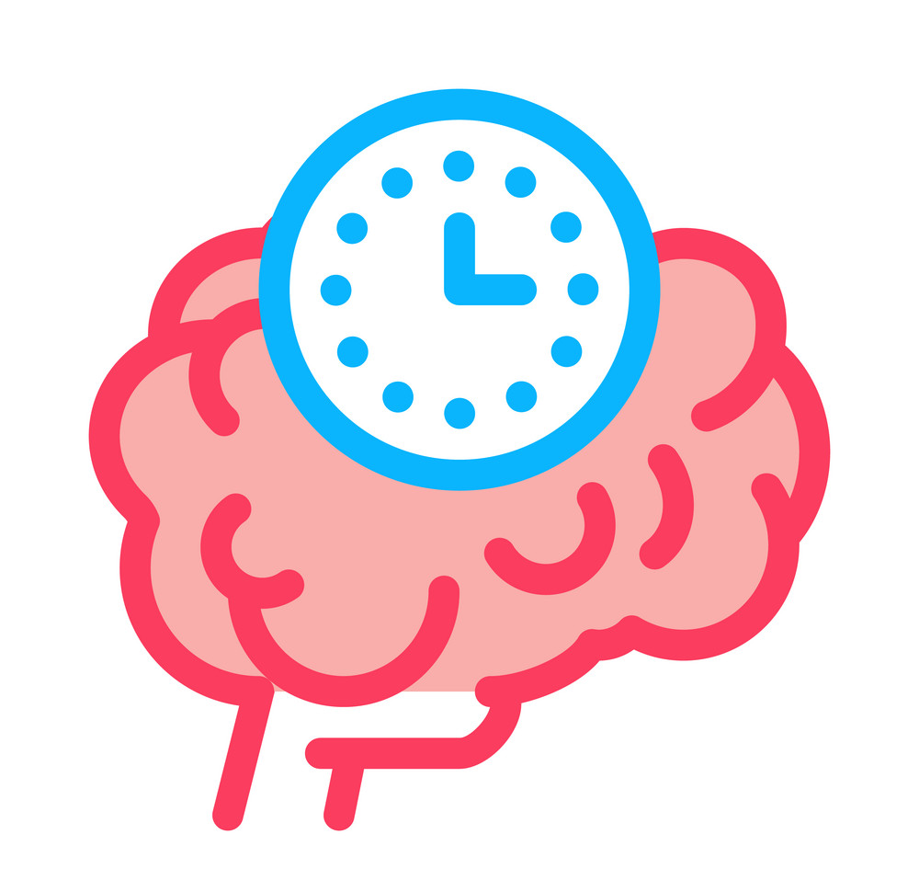

Hypothesis
As the number of positive training observations increase…
Accuracy of correctly judging whether a new instance belongs to a concept will increase
Reaction time will decrease

Slide 9
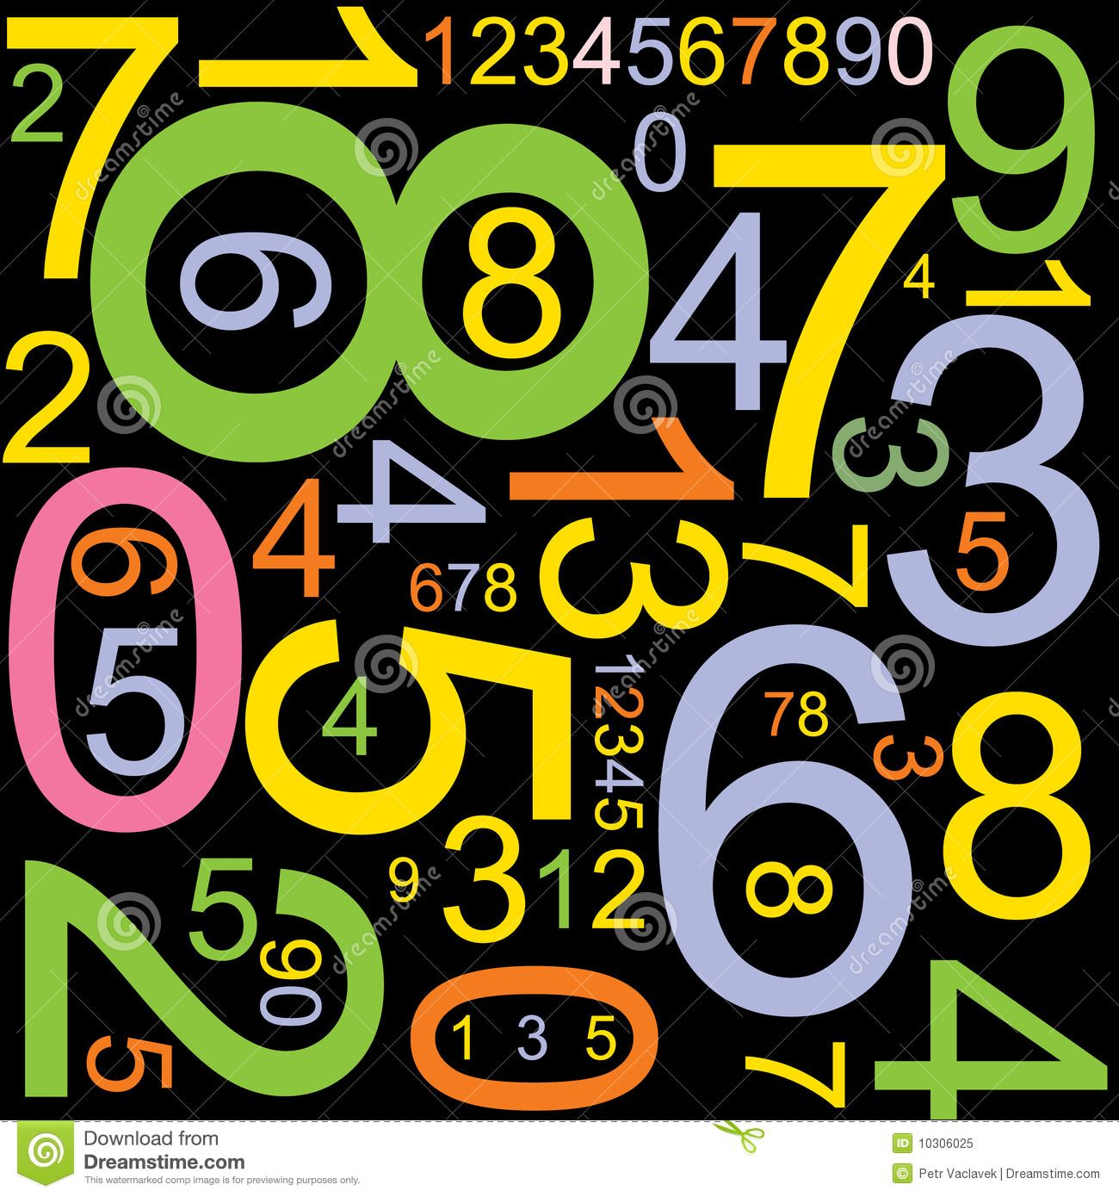
Methods
Eight participants were recruited
Four different number concepts were used
Even → {2,4,6}
Odd → {1,3,5}
Multiples of ten → {10,20,30}
Negative → {-5,-6,-7}
IV: Number of training observations
1. Sequence of three numbers shown
2. Sequence of seven numbers shown
DV: Accuracy & response time

Slide 10
Procedure
Participants experienced four sessions (one for each number concept)
For each session → two phases:
Phase I (Train): Three numbers belonging to concept displayed for two seconds each
Phase I (Test): Participants immediately answered six questions sets determining if a group of three numbers belonged or did not belong to the concept.
Phase II (Train): Seven numbers belonging to concept displayed for two seconds each
Phase II (Test): Same as Phase II but with different numbers
Does this belong? → {3,-9,8}
20
80
30
…
Does this belong? → {40,90,70}
Does this belong? → {55,7,4}
…
TRAIN
TEST

Slide 11
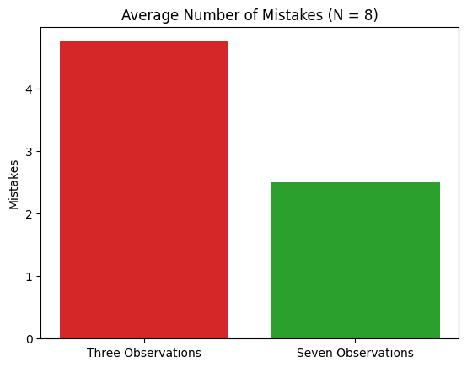
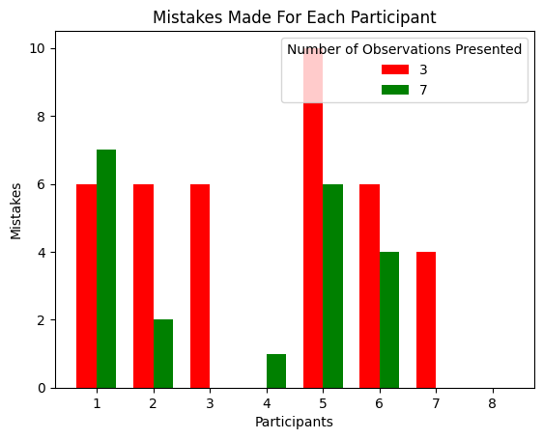
Results: Accuracy
Average number of mistakes decreased with more observations
Accuracy improved from 20.8% to 58.3%
Paired t-tests revealed significance: t(7) = 2.32, p < .05, d =0.57

Slide 12
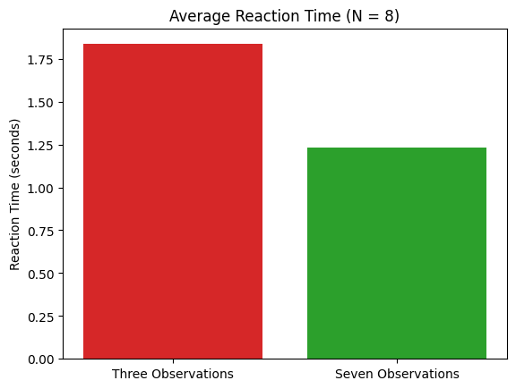
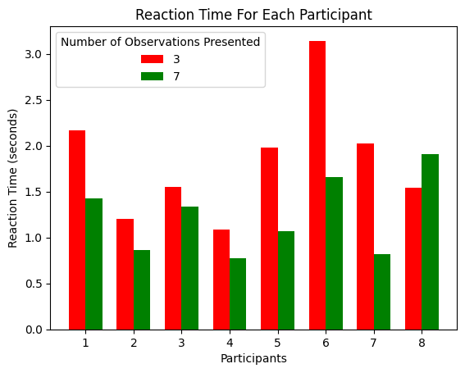
Results: Reaction Time
Average reaction time decreased with more observations
Reaction time decreased from 1.83 to 1.23 seconds
Paired t-tests revealed significance: t(7) =1.12, p < .05, d =0.34

Slide 13
Discussion - Limitations
Besides sample size…
Homogenous group of participants in terms of age and educational background restricts external validity of the results
Because it was designed as a numerical task, individual differences in mathematical ability can bias results
Because participants did not know the possible options of the four concepts, since number properties are not mutually exclusive → chance that participant found some other pattern between concepts that did not necessarily correspond to one of the four, but can be correct as well
Ecological validity: Using number properties as concepts may undermine the complexity of real world concepts in dynamic settings

Slide 14

Discussion - Future Directions & Applications
Future Questions:
Transferability of Bayesian framework: To what extent can the Bayesian framework be applied to diverse conceptual domains beyond numerical categories?
Long-term concept retention: What is the durability of knowledge acquired through Bayesian-informed learning as time passes?
Potential Applications
Educational Settings: Curricula could be designed to provide increased number of examples to optimize knowledge acquisition
Artificial Intelligence: Integrating computational Bayesian frameworks into machine learning models may enhance the ability to generalize and adapt to new information

Slide 15
References
Tenenbaum, J. (1998). Bayesian modeling of human concept learning. Advances in neural information processing systems, 11.
Goodman, N. D., Tenenbaum, J. B., Feldman, J., & Griffiths, T. L. (2008). A rational analysis of rule‐based concept learning. Cognitive science, 32(1), 108-154.
Shi, L., Griffiths, T. L., Feldman, N. H., & Sanborn, A. N. (2010). Exemplar models as a mechanism for performing Bayesian inference. Psychonomic bulletin &
review, 17(4).
Nosofsky, R. M. (1991). Tests of an exemplar model for relating perceptual classification and recognition memory. Journal of experimental psychology: human
perception and performance, 17(1), 3.
Rosch, E. (1973). Prototype theory. Cognitive development and the acquisition of language, 111-144.
Tenenbaum, J. (1999). Rules and similarity in concept learning. Advances in neural information processing systems, 12.

Slide 16
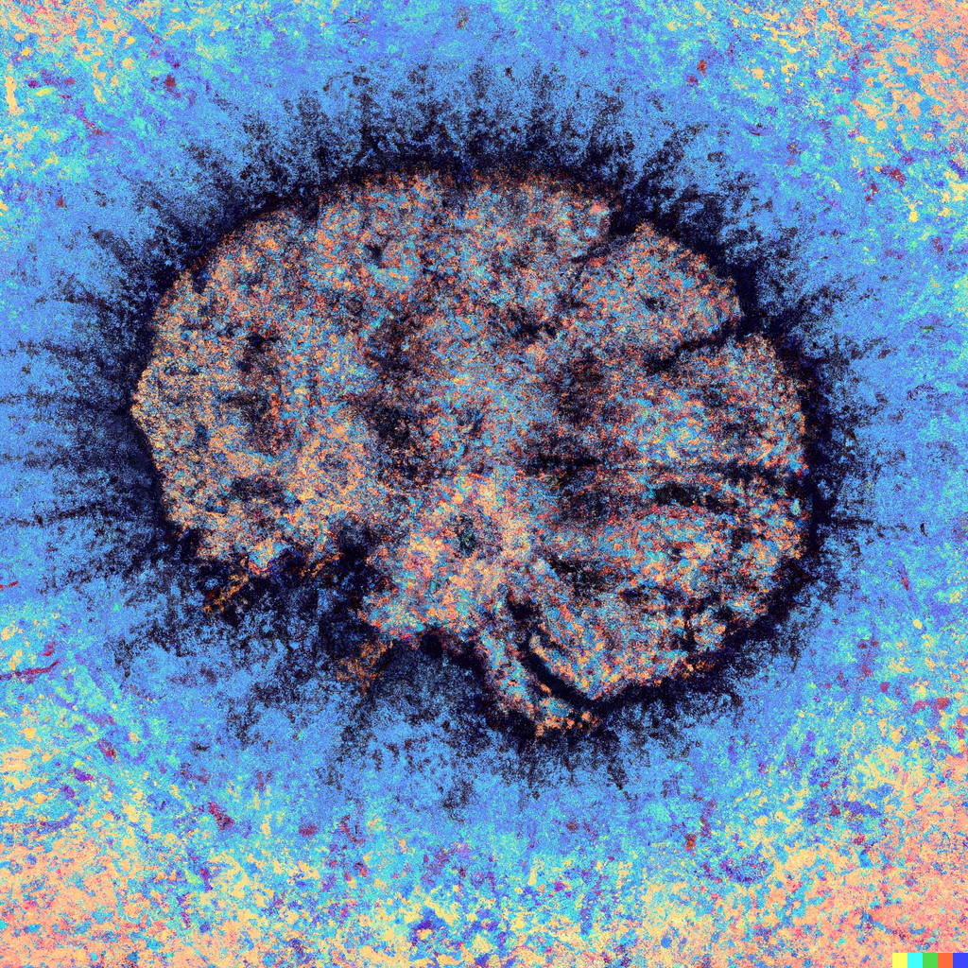
Thank You for Listening
Questions?

